Slide 1
Big Data and me
Murzabekov Almaz
HSE, 09.2019

Slide 2
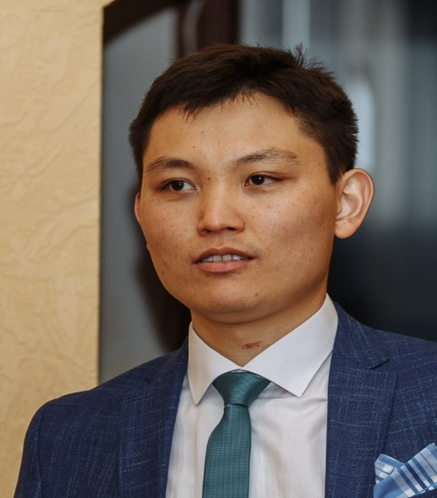





Project analysis slide 2
About me
FIRST PROGRAM (14 y.o.)
FIZ-MAT LICEUM
SSTU
DBA ENGINEER
ETL-DEVELOPER
ORACLE CERT
SOLDIER
SENIOR DEVELOPER
ACQUIRING SYSTEM (high-load)
BIG DATA ENGINEER
GRAPH DATA MINING
LEAD BIG DATA ENGINEER
DATA CLOUD
(aka DATA LAKE)
HSE STUDENT
DESIGN & UX
FUTURE AND GOALS

Slide 3


Project analysis slide 2
My area of interests
SOFTWARE ENGINERING
DATA ENGINEERING
ALGO TRADING
DESIGN, GUI, UX
FINANCE
SOFT SKILLS

Slide 4
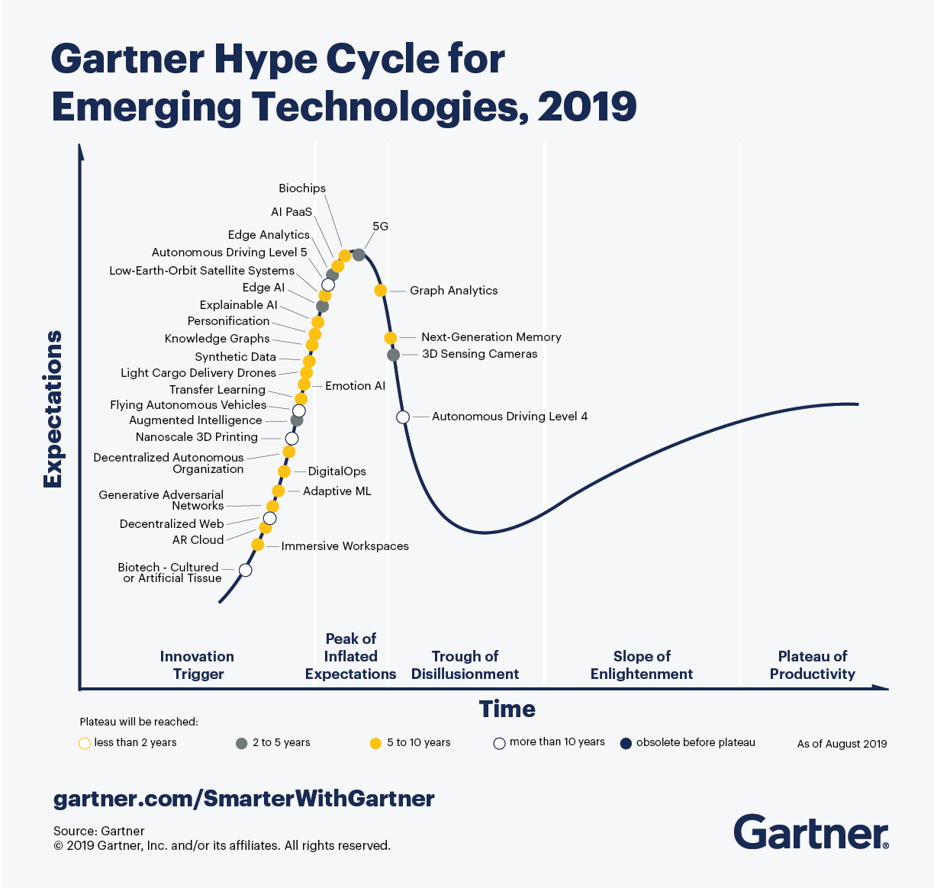
Project analysis slide 5
Big Data as a platform

Slide 5
Project analysis slide 3
Why Big data?
MARKETINGS
TECHNICAL ENGINEERING
FINANCE
ECONOMICS
SOCIAL
LIFE

Slide 6
Project analysis slide 2
Misunderstandings
MACHINE LEARNING
DATA ENGINEERING
DATA SCIENCE
DATA VISUALIZATION
DATA ANALISYS/ MINING
DATA MANAGEMENT

Slide 7
Project analysis slide 6
Who is a good Big Data engineer?
Goal orientation
Self-education & curious
Energy
Soft skills
Hard skills

Slide 8
Thank You

